Slide 1
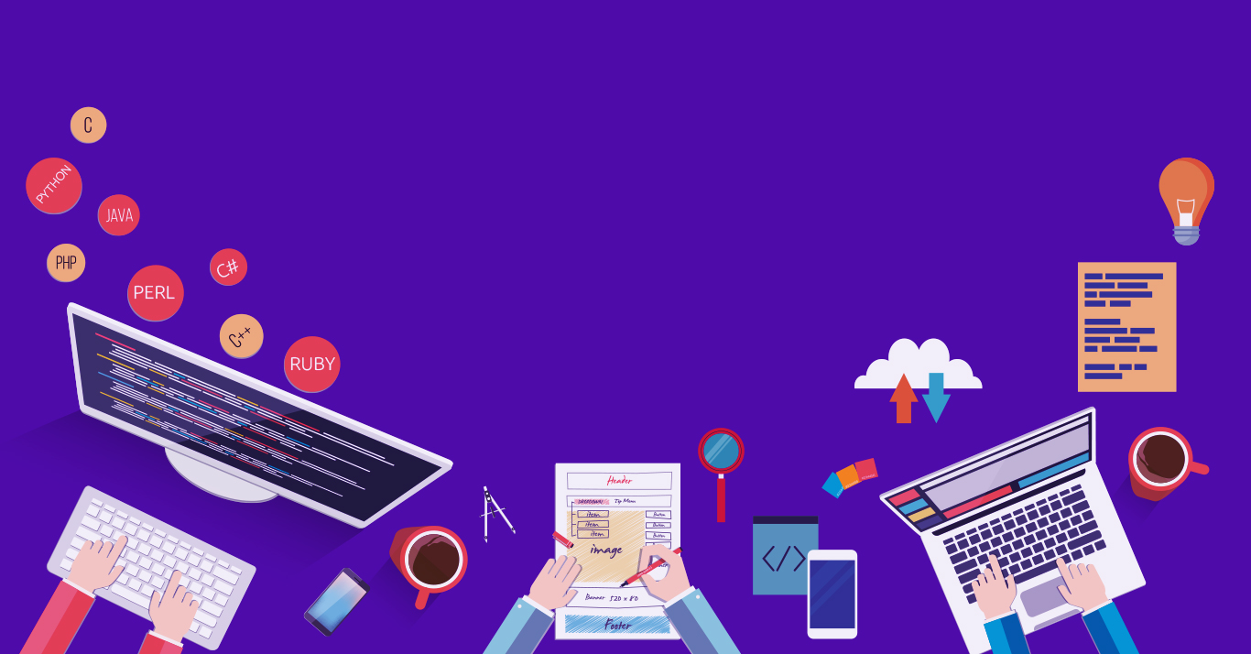

Introduction to
Robotic Process Automation
Title of the Project
Reg no : 220701254
Name : Sarveshwaran K
Project title: Energy Consuption tracker
Designation and Department : 3rd year CSE -D

Slide 2
Abstract
Efficient energy consumption is a critical need in today's world to mitigate environmental impact and reduce energy costs. The Energy Consumption Tracker is a digital solution designed to monitor, analyze, and optimize energy usage in households, businesses, and industries. By leveraging IoT sensors and data analytics, the system provides real-time insights into energy consumption patterns, identifies inefficiencies, and offers recommendations for sustainable usage.
Key features include a user-friendly interface, detailed consumption reports, and customizable alerts for excessive usage. Additionally, integration with renewable energy sources and predictive analytics ensures a comprehensive approach to energy management. This project aims to empower users to make informed decisions, reduce energy waste, and contribute to a greener future.
The proposed tracker not only promotes energy efficiency but also supports broader sustainability goals, aligning with global initiatives to combat climate change and resource depletion.

Slide 3
Need for the Proposed System
Needs for an Energy Consumption Tracker
Monitoring Energy Usage To provide real-time visibility into energy consumption, enabling users to understand how and where energy is being used.
Reducing Energy Costs By identifying patterns of excessive usage, the tracker helps users minimize unnecessary energy expenditure and lower utility bills.
Promoting Energy Efficiency Supports users in adopting sustainable practices by offering insights and recommendations for optimizing energy use.
Environmental Sustainability Helps reduce energy waste, decreasing the carbon footprint and supporting global efforts to combat climate change.
Integration with Smart Technology Modern homes and industries require seamless integration with IoT devices for automation and smarter energy management.
Custom Alerts and Notifications Alerts users about anomalies, such as unusual spikes in energy consumption, helping them address issues promptly.
Data-Driven Decision-Making Provides detailed reports and analytics, allowing users to track usage trends and make informed decisions.
Support for Renewable Energy Ensures compatibility with renewable energy sources like solar panels, enabling efficient utilization of green energy.
Scalability A solution that caters to diverse needs—from individual households to large-scale industrial operations.
Compliance with Regulations Helps businesses meet energy efficiency standards and comply with local and international regulations.

Slide 4
Advantages of the Proposed System
Advantages of an Energy Consumption Tracker
Real-Time Monitoring
Tracks energy usage in real-time, providing immediate insights into consumption patterns.
Cost Savings
Identifies energy wastage and inefficiencies, enabling users to reduce electricity bills through optimized usage.
Environmental Benefits
Promotes energy conservation, contributing to reduced carbon footprints and supporting global sustainability efforts.
Data-Driven Decision Making
Offers detailed reports and analytics, helping users make informed decisions to improve energy efficiency.
Custom Alerts and Notifications
Sends alerts for unusual consumption patterns or when usage exceeds predefined limits, preventing overuse.
Integration with Renewable Energy
Supports monitoring and optimization of renewable energy sources like solar panels, ensuring efficient energy management.
User-Friendly Interface
Provides a simple, accessible platform for users to track and manage their energy consumption.
Encourages Sustainable Habits
Raises awareness about energy usage, fostering habits that align with environmental conservation.
Scalability and Customization
Suitable for households, businesses, and industrial applications with customizable features to meet specific needs.
Enhanced Energy Security
Helps avoid overloading the system by balancing energy usage, reducing the risk of power outages.
By leveraging these advantages, an energy consumption tracker empowers users to save costs, conserve energy, and contribute to a more sustainable future.

Slide 5
Main Objective
The primary objective of the Energy Consumption Tracker is to provide an efficient and user-friendly system for monitoring, analyzing, and optimizing energy usage. This tool aims to help individuals and organizations:
Track Real-Time Energy Consumption: Provide accurate, real-time data on energy usage to enhance awareness and transparency.
Identify Inefficiencies: Detect patterns, devices, or systems that contribute to excessive energy consumption.
Promote Energy Savings: Offer actionable insights and recommendations to reduce energy costs and waste.
Encourage Sustainable Practices: Support users in adopting energy-efficient behaviors and integrating renewable energy sources.
Facilitate Decision-Making: Enable informed decisions about energy usage through detailed reports and predictive analytics.
Ultimately, the tracker seeks to promote environmental sustainability and cost efficiency while supporting global efforts to combat energy-related challenges.

Slide 6
Architecture
The architecture of the Energy Consumption Tracker consists of three main components:
Data Collection Layer: IoT sensors or smart meters installed in the monitored environment collect real-time energy usage data, which is then transmitted to a central server.
Processing Layer: The server processes the incoming data using a backend system built with technologies such as Node.js and databases like MySQL to store usage patterns, perform analysis, and generate insights.
User Interface Layer: A web or mobile application displays the processed data, offering features like real-time tracking, reports, alerts, and recommendations for energy optimization. This layer also allows users to interact with the system for data review and control.
This architecture ensures efficient data flow, secure storage, and easy accessibility for end users.

Slide 7
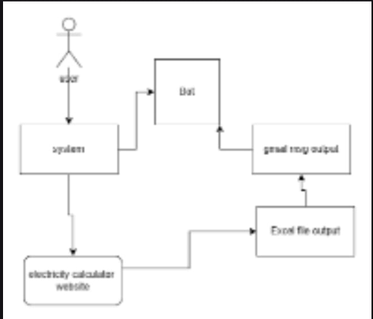
Architeuctre

Slide 8
System Requirements
Hardware:Pc or laptop with ui path studio installed
Software:ui pathstdio ,email,electricity calcultor website

Slide 9
Functional Description
An energy consumption tracker monitors and records electricity usage in real-time, providing insights into energy consumption patterns. It helps users identify high-energy appliances, optimize usage, reduce costs, and track sustainability goals through detailed analytics and alerts.

Slide 10
Process Design
Low-Power Architecture: Use energy-efficient processors like ARM Cortex-M or RISC-V with sleep and low-power modes.
Integrated Sensors: Embed ADCs and interfaces to collect real-time energy data from sources like current/voltage sensors.
3. Edge Processing: Perform lightweight data processing (e.g., filtering, aggregation) to reduce data transfer and save energy.
4. Communication Modules: Include low-energy communication (e.g., BLE, Zigbee) for data transmission.
5. Optimized Algorithms: Employ energy-efficient firmware for data analysis and predictive insights.

Slide 11
Conclusions
In conclusion, an electric energy consumption tracker serves as a powerful tool to monitor and optimize energy usage. By providing real-time insights, it promotes cost savings, encourages energy efficiency, and supports sustainable living. Implementing such a system can lead to better decision-making, reduced environmental impact, and long-term financial benefits.

Slide 12
Future Enhancement
Description 1
Future enhancements for an Energy Consumption Tracker could include integrating AI-based predictive analytics for optimizing energy use and adding real-time energy forecasting based on historical patterns and environmental factors.
Description 2
Additionally, integrating with smart home systems for automated energy-saving actions could enhance user experience.

Slide 13
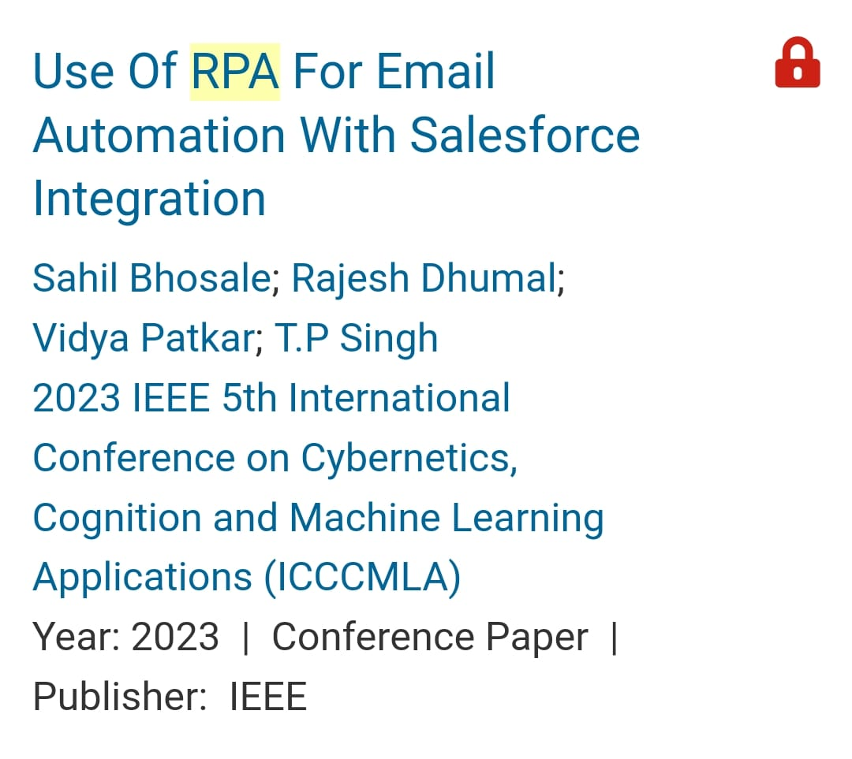
IEEE Paper

Slide 14
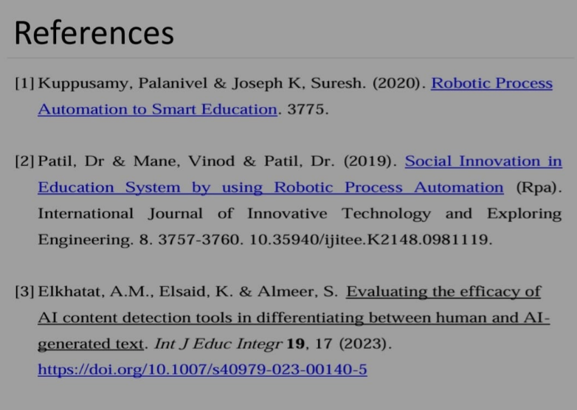
References

Slide 15
Queries

Slide 16
Demonstration

Slide 17
Thank You

